Slide 1

CSE-326
LAYERED ARCHITECTURE
Group-5
2005005
2005019
2005021
2005024
2005027
2005030

Slide 2

KEY LAYERS
Presentation Layer (User Interface and API Gateway)
Business Logic Layer (Core Services)
Persistence Layer (Data Access)
Database Layer (Data Storage)
Integration Layer (External Systems and Services)
Infrastructure Layer (Deployment, Scalability, and Operational Support)

Slide 3
PRESENTATION LAYER
Purpose:
Provides user interaction points and a consistent entry into the backend services. This layer ensures that the students, institutions, and admin users experience a clear, accessible interface and that requests are routed appropriately.

Slide 4
Components/Services:
Frontends:
Student UI: A responsive interface for student registration, login, profile viewing, college searching, selection and modification of ESVG preference order, addition of quota info, checking application status, viewing allocated college, paying fees and uploading (quota) documents.
Institution Portal: For institutions to log in, request for updating seat/quota information, and verify documents.
Admin Dashboard: For administrative staff to control application periods, modify rules, publish notices, initiate allocation runs, and monitor run status.
Technology: React.js (Component-Based Architecture, promotes reusability and modular)

Slide 5
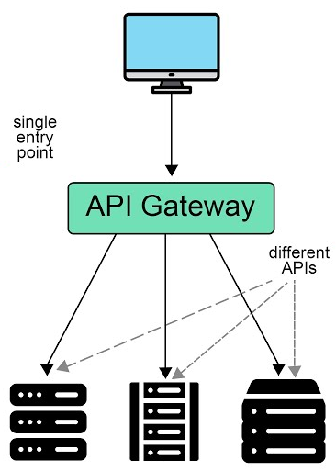
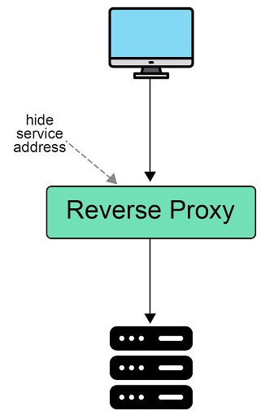
API Gateway: A single entry point that routes requests from frontends to the appropriate backend services.
Reverse Proxy: Forwards client requests by resolving HTTPS to HTTP for upstream servers while hiding backend details.
Technology: API Gateway, Reverse Proxy: NGINX

Slide 6
BUSINESS LOGIC LAYER
Purpose:
Implements all the core rules and workflows of the application and allocation system, ensuring that the system’s logic is well-structured and independent of UI or data storage details.

Slide 7
Key Services:
Student:
StudentProfileService:
Handles creation and validation of student profiles, ensuring eligibility criteria (passing SSC within the last 3 years) are met.
ApplicationService:
Manages the student application process:
Ensure the student is allowed to apply to particular groups and institution types (e.g. women college).
Ensure that the student meets the minimum requirement for selected ESVG and all payments are completed.
Management of the preference list (SVGs, quota selections).

Slide 8
DocumentUploadService:
Handles upload document requests.
PaymentService:
Processes application and confirmation fee payments. Interacts with Integration Layer for external payment gateways. Ensures payment completion before allowing next steps (application submission, confirmation, etc.).
ViewResultService:
View the allocation results. On result day, handles a large volume of concurrent requests.

Slide 9
College:
UpdateCollegeInfoService:
Handles institution’s request to update their seat, quota, shift-version-group (SVG) configurations.
DocumentVerificationService:
Processes institution-side document approval submissions for special quotas. Updates student status based on approval or rejection.

Slide 10
Admin :
AdminUtilityService:
provides admin utility services, such as, starting and ending run, show overall application statistics, search, view and modify a specific application.
RulesChangeService:
Facilitates admin to update different rules, such as, group change rules, quota priority and quota percentage.
MigrationService:
Handles logic of migrating students to better-preferred colleges if vacancies arise after the initial allocation round.

Slide 11
Admin :
AllocationService:
Implements the allocation algorithms:
First run allocation based on merit, quota, and seats availability following the rules specified by the board. In case of tie in merit, tie is broken according to obtained marks in individual subjects following proper rules.
Subsequent runs for migration and re-allocation.
Consider preferences, quotas (Freedom Fighter, Education Quota, Special Quota), and available seats.

Slide 12
Technology:
Backend Services: Spring Boot with embedded Tomcat. (Wide Industry Adoption, Microservices-Friendly, Embedded Server Support)
Internal communication: Eureka Naming Server (Eureka is an open-source service registry that serves as a central hub for maintaining a registry of all active service instances.)

Slide 13
PERSISTENCE LAYER
Purpose:
Abstracts database interactions from the business logic. Provides a clean interface to query, insert, update, and delete domain entities.

Slide 14
Components/Services:
Data Access Objects (DAO):
A set of objects handle CRUD operations and complex queries.
Student: StudentInfo, SSCResultInfo, ApplicationInfo, AllocationResult, QuotaDocument, PaymentRecord
College: CollegeInfo, ESVG
Admin: GroupChangeRules, PaymentRules
Technology: Query Builder: Hibernate ORM(Java) (Easy migration between DBs, Object oriented)

Slide 15
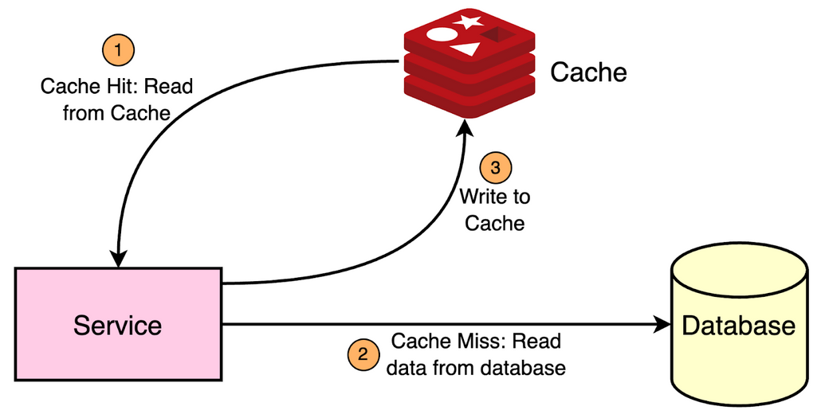
Components/Services:
Cache:
For caching frequently accessed data (e.g., seat availability, quota info, institution lists, result data on result day) to reduce load on the DB.
Technology: Redis (High Performance, Scalable, Ease of Use: Redis has a simple API and comprehensive documentation, making it easy to integrate into applications)

Slide 16
DATABASE LAYER
Purpose:
Stores and manages the system’s persistent data.

Slide 17
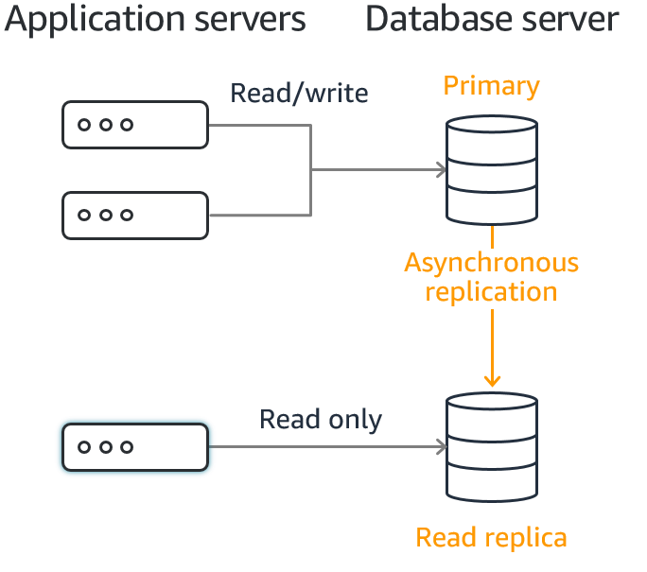
Components/Services:
Primary DB:
Stores structured data such as user profiles, result, college details, quotas, application submissions, and allocations etc.
Technology: MySQL (Open source and Compatibility with enterprise tools.)
Read Replicas:
Read replicas are read-only copies of the primary MySQL instance of the DB system within the same region. For scaling read-heavy endpoints (like viewing results or colleges’ information), multiple read replicas will be utilized behind a load balancer to improve read performance.
Technology: MySQL (As MySQL is used as primary storage)

Slide 18
INTEGRATION LAYER
Purpose:
Handles communication with external services and systems. This layer is critical for integrating third-party payment gateways, SMS gateways for notifications, and external verification APIs.

Slide 19
Components/Services:
Payment Gateway Integration:
Interacts with external payment providers (e.g., SSLCommerz, Sonali Bank, Bkash) to pay application and confirmation fee.
SMS/Notification Services:
Uses third-party services to send OTPs, payment confirmations, result announcements.
External Verification APIs:
Integrates with government education boards for SSC result verification and foreign credential evaluation services.
Technology:
RESTful APIs: Spring Boot provides built-in features for creating RESTful APIs and integrating with external services, using REST clients and connectors.
Message queues: RabbitMQ for asynchronous communitation and to handle spike loads in a decoupled manner.

Slide 20
INFRASTRUCTURE LAYER
Purpose:
Provides the foundational elements for deployment, scaling, monitoring, and maintenance of the system. Ensures the system runs smoothly during peak loads (e.g., deadline days, result announcement day).

Slide 21
Components/Services:
Hosting Platform: Runs the application on a scalable cloud infrastructure.
Technology:
Google Cloud SQL for MySQL
Google Cloud Memory Store for Redis
Google Kubernetes Engine
Cloudflare for DNS management and DDoS protection
Load Balancer: Distribute traffic among multiple servers to handle increased traffic.
Technology: Kubernetes internal load balancer.

Slide 22
Components/Services:
Container: Containers are lightweight, standalone, executable packages that include everything needed to run a piece of software, including the code, runtime, system tools, libraries, and settings. Ensures consistent deployment across environments.
Technology: Containerization with Docker, orchestration with Kubernetes for scaling based on traffic and load.
CI/CD Pipelining tool:
Automated testing, integration, and deployment pipeline ensures new features and fixes are safely and quickly deployed.
Technology: Jenkins for CI/CD pipeline (as it is open source)
Monitoring & Logging tool:
For performance metrics, error logs, and alerting. Helps pinpoint bottlenecks in peak usage times and ensures proactive scaling and troubleshooting.
Technology: Prometheus, Grafana for Logging

Slide 23
Components/Services:
Backup & Disaster Recovery tool: To ensure data integrity and availability.
Technology: Automate backups (Google Cloud SQL for MySQL)

Slide 24
THANK YOU

